Slide 1

Time Series Analysis:
Apple Stock Price
By
Yuehchao Wu

Slide 2
Dataset Description
Source: Yahoo! Finance
Apple Daily Stock Price
first day of February 2002 - the last day of January 2017
3775 Observations

Slide 3
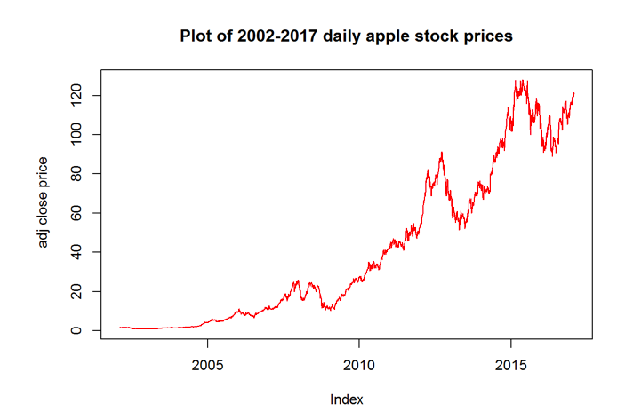
Exploratory Analysis:
Stock price
Upward Trend
Up and Down
2002-2005: little growth
2010-2015: Rapid increase

Slide 4
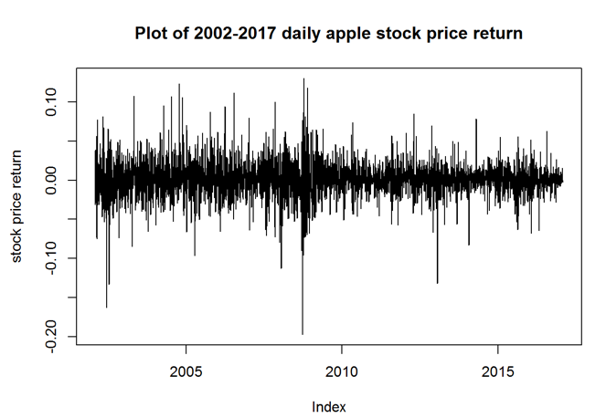
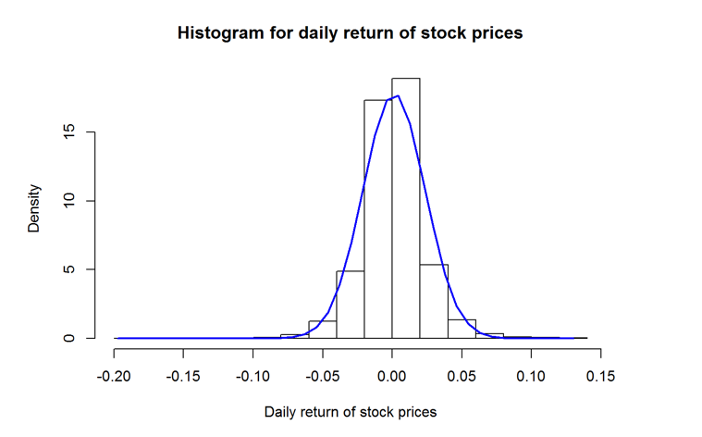
Exploratory Analysis:
Stock price log return

Slide 5
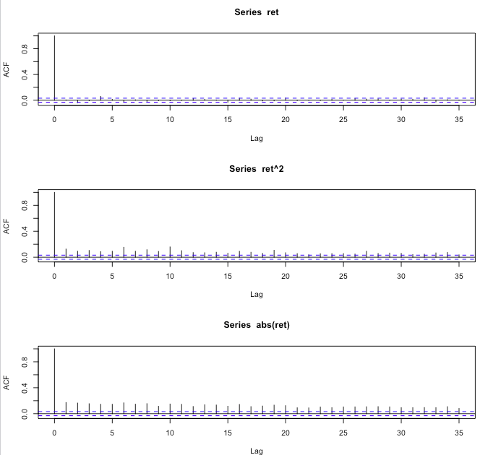
Exploratory Analysis:
Stock price log return
Non linear Dependency
ARCH EFFECT

Slide 6

Modeling approach
T-distribution: Fat Tail
GARCH models: Non constant Volatility
AR(0): Constant mean

Slide 7
BIC
GARCH (1,1),T | -5.0088
GARCH (1,1), skewed T | -5.0068
EGARCH (1,1),T | -5.0192
IGARCH (1,1), T | -5.0108
FGARCH (1,1), T | -5.0162

Slide 8
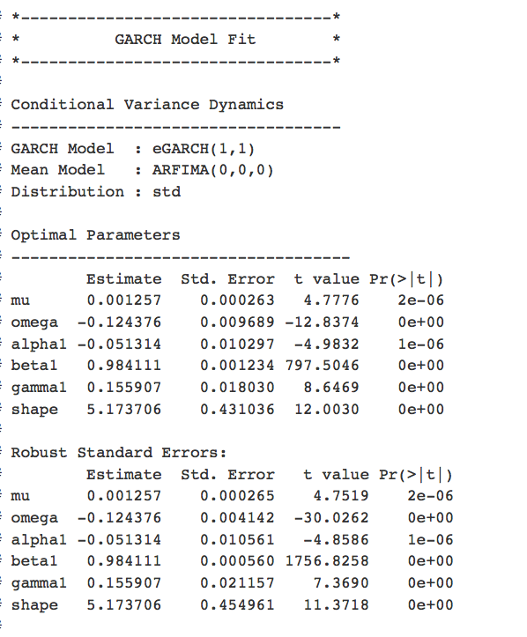
Our Model:

Slide 9
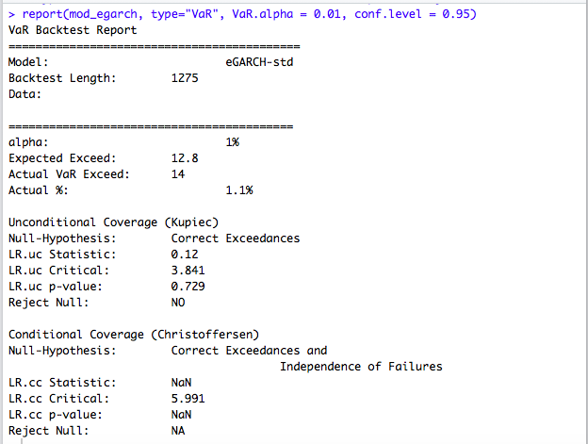
Validation of model (backtesting)

Slide 10
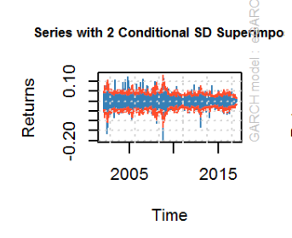
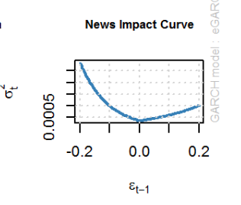
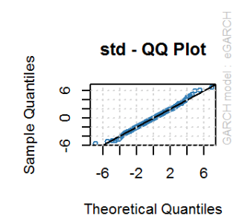
Interpretation of results

Slide 11
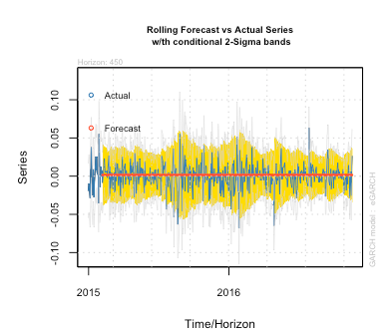
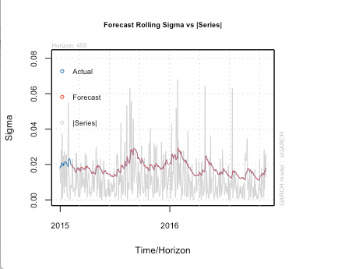
Forecasting

Slide 12
Conclusion and Reflection
Adequate
capture the asymmetric volatility
More impact on Volatility of Negative shock
Value at Risk -> Risk Management
Limitation: Extreme values

